Slide 1
New Frontiers of Knowledge Graph Reasoning: Recent Advances and Future Trends
Part III, Neural Reasoning for Logical Queries
Zihao Wang
Department of CSE, HKUST

Slide 2

Roadmap
Part I: Knowledge Graph Reasoning: Basic Concepts and Techniques
Part II: Recent Advance #1: Neural Reasoning for Natural Language Queries
Part III: Recent Advance #2: Neural Reasoning for Logical Queries
Part IV: Recent Advance #3: Neural Reasoning Beyond Entities and Relations
Part V: Recent Advance #4: LLM+KGR
Part VI: Open Challenges and Future Directions
Notes:
Today’s tutorial contains 4 parts.
At the beginning, I would like to give some background regarding the knowledge graph reasoning as well as the unique challenges behind this problem setting.
In part 1, we will introduce the details of general knowledge graph reasoning. and in part 2, we will introduce query specific knowledge graph reasoning. And finally, we will discuss the future trends for knowledge graph reasoning.

Slide 3
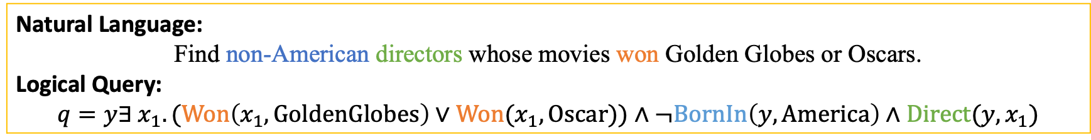
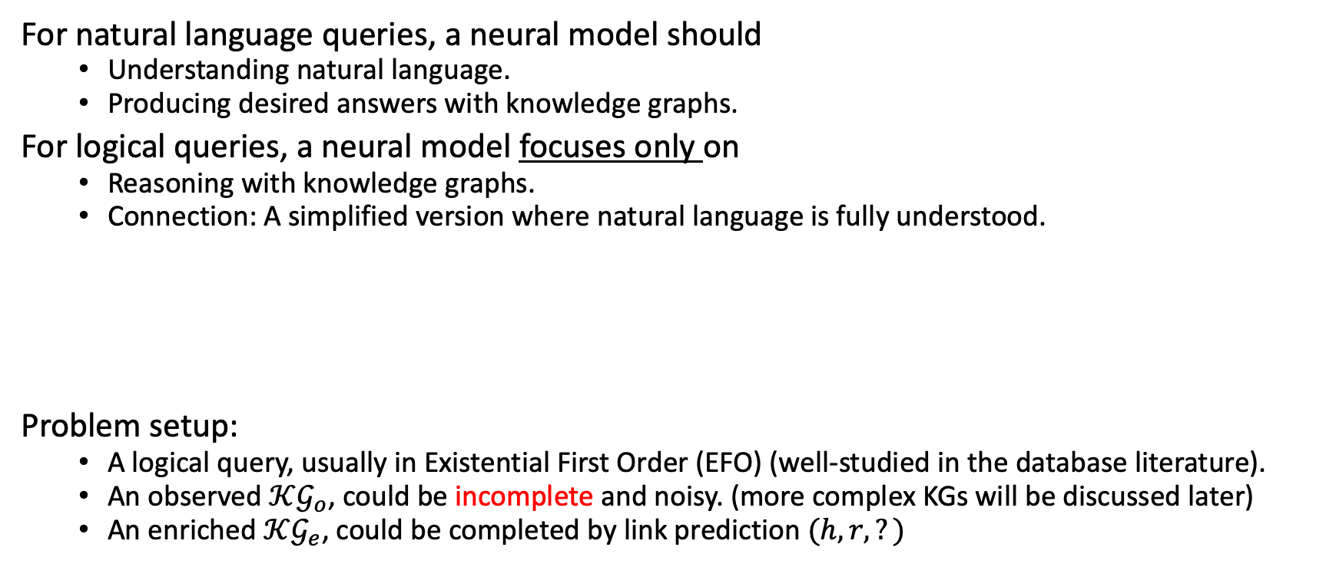
Why study logical queries
For natural language queries, a neural model should
Understanding natural language.
Producing desired answers with knowledge graphs.
For logical queries, a neural model focuses only on
Reasoning with knowledge graphs.
Connection: A simplified version where natural language is fully understood.
Problem setup:
A logical query, usually in Existential First Order (EFO) (well-studied in the database literature).
An observed $𝒦𝒢_{o}$, could be incomplete and noisy. (more complex KGs will be discussed later)
An enriched $𝒦𝒢_{e}$, could be completed by link prediction $(h,r,?)$
Natural Language:
Find non-American directors whose movies won Golden Globes or Oscars.
Logical Query:
$$q=y∃ x_{1}.(Won\left(x_{1},GoldenGlobes\right)∨Won(x_{1},Oscar))∧¬BornIn\left(y,America\right)∧Direct(y,x_{1})$$

Slide 4
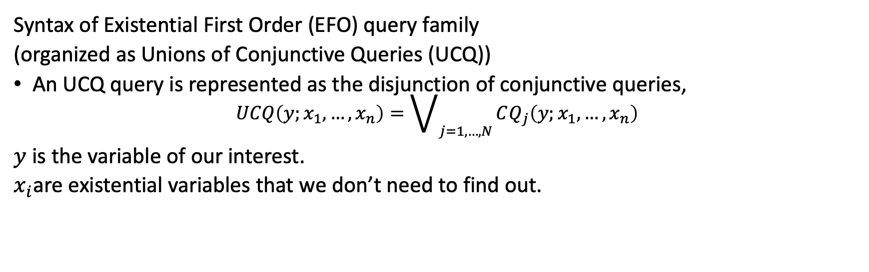
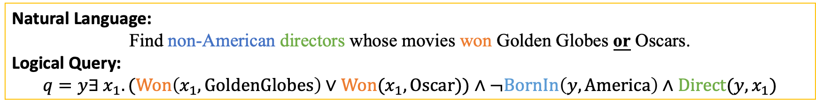
Background: Query syntax
Natural Language:
Find non-American directors whose movies won Golden Globes or Oscars.
Logical Query:
$$q=y∃ x_{1}.(Won\left(x_{1},GoldenGlobes\right)∨Won(x_{1},Oscar))∧¬BornIn\left(y,America\right)∧Direct(y,x_{1})$$
Syntax of Existential First Order (EFO) query family
(organized as Unions of Conjunctive Queries (UCQ))
An UCQ query is represented as the disjunction of conjunctive queries,
$$UCQ\left(y;x_{1},…,x_{n}\right)=\bigvee_{j=1,…,N}{CQ_{j}\left(y;x_{1},…,x_{n}\right)}$$
$y$ is the variable of our interest.
$x_{i}$are existential variables that we don’t need to find out.
$$q\left(y;x\right)=SetUnion\left(\begin{aligned}y∃ x_{1}.\left(Won\left(x_{1},GoldenGlobes\right)∧¬BornIn\left(y,America\right)∧Direct\left(y,x_{1}\right)\right), \\ y∃ x_{1}.\left(Won\left(x_{1},Oscar\right)∧¬BornIn\left(y,America\right)∧Direct\left(y,x_{1}\right)\right)\end{aligned}\right)$$

Slide 5
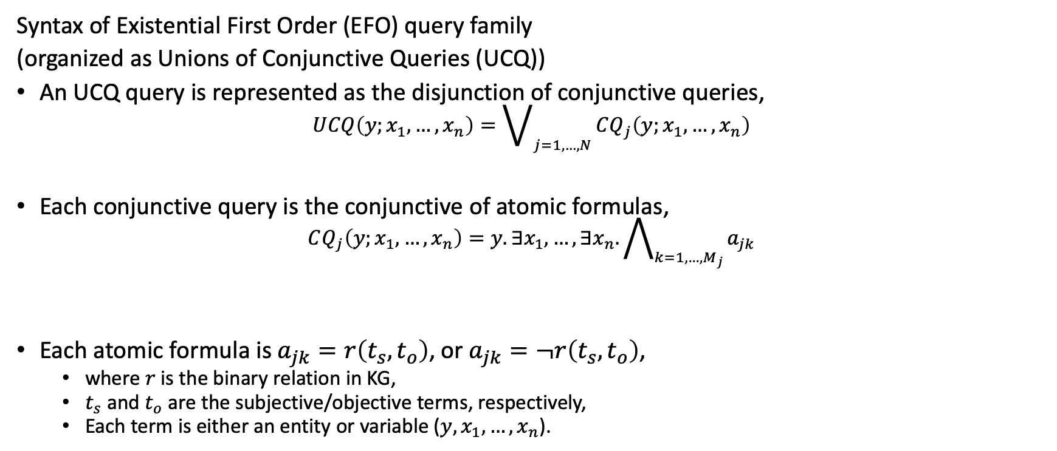
Background: Query syntax
Syntax of Existential First Order (EFO) query family
(organized as Unions of Conjunctive Queries (UCQ))
An UCQ query is represented as the disjunction of conjunctive queries,
$$UCQ\left(y;x_{1},…,x_{n}\right)=\bigvee_{j=1,…,N}{CQ_{j}\left(y;x_{1},…,x_{n}\right)}$$
Each conjunctive query is the conjunctive of atomic formulas,
$$CQ_{j}\left(y;x_{1},…,x_{n}\right)=y.∃x_{1},…,∃x_{n}.\bigwedge_{k=1, …,M_{j}}{a_{jk}}$$
Each atomic formula is $a_{jk}=r\left(t_{s},t_{o}\right)$, or $a_{jk}=¬r\left(t_{s},t_{o}\right)$,
where $r$ is the binary relation in KG,
$t_{s}$ and $t_{o}$ are the subjective/objective terms, respectively,
Each term is either an entity or variable ($y,x_{1},…,x_{n}$).
$$y∃ x_{1}.\left(Won\left(x_{1},GoldenGlobes\right)∧¬BornIn\left(y,America\right)∧Direct\left(y,x_{1}\right)\right)$$

Slide 6
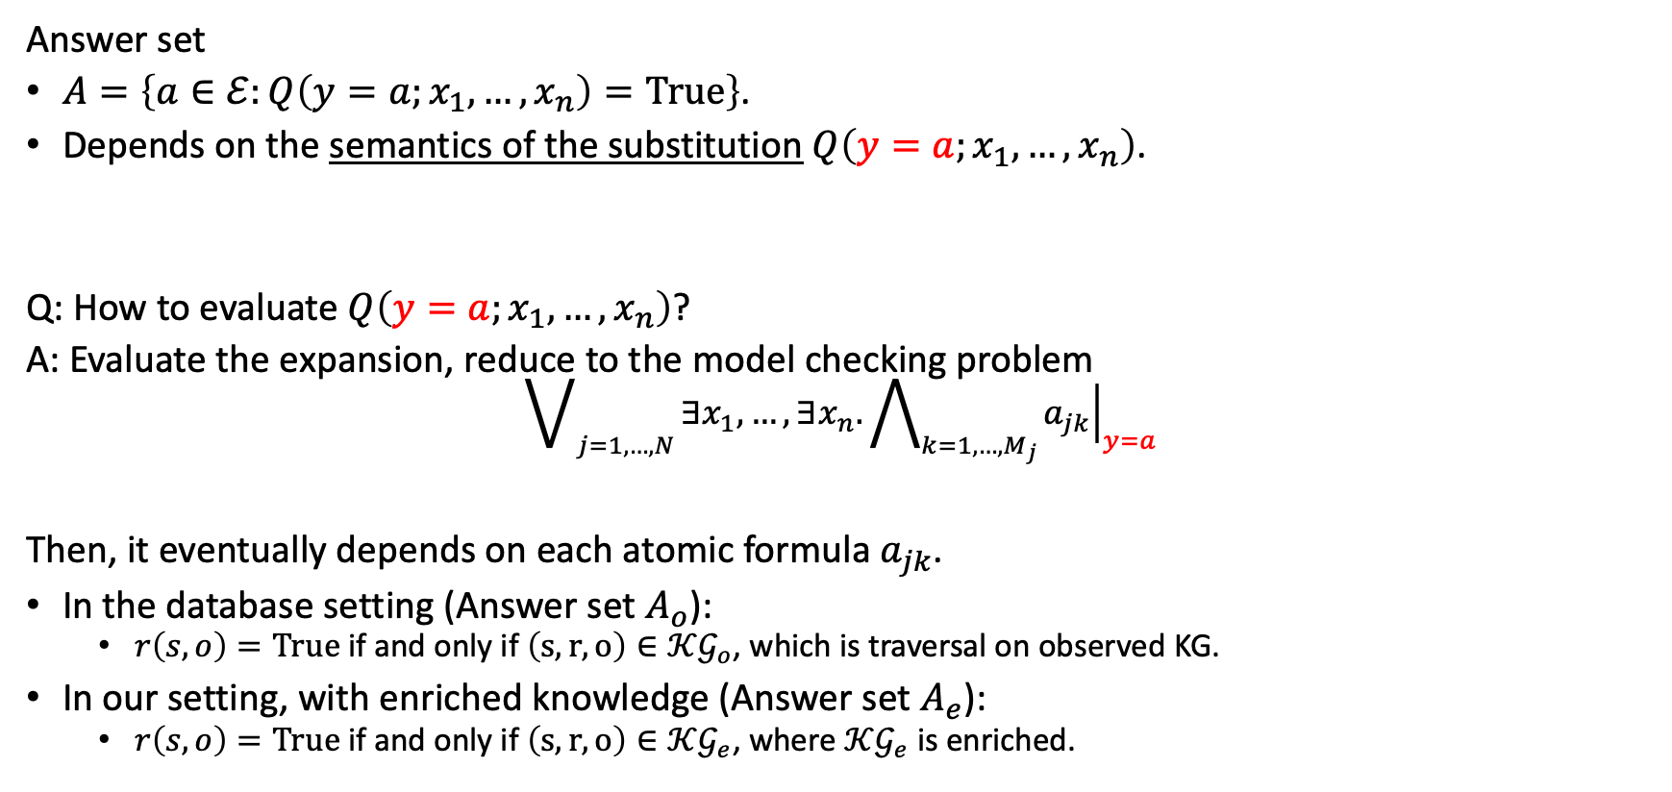
Background: Query Semantics
Answer set
$A=\left\{a∈ℰ:Q\left(y=a;x_{1},…,x_{n}\right)=True\right\}$.
Depends on the semantics of the substitution $Q\left(y=a;x_{1},…,x_{n}\right)$.
Q: How to evaluate $Q\left(y=a;x_{1},…,x_{n}\right)$?
A: Evaluate the expansion, reduce to the model checking problem
$$\bigvee_{j=1,…,N}{∃x_{1},…,∃x_{n}.\bigwedge_{k=1, …,M_{j}}{{\left.a_{jk}\right|}_{y=a}}}$$
Then, it eventually depends on each atomic formula $a_{jk}$.
In the database setting (Answer set $A_{o}$):
$r\left(s,o\right)=True$ if and only if $\left(s,r,o\right)∈𝒦𝒢_{o}$, which is traversal on observed KG.
In our setting, with enriched knowledge (Answer set $A_{e}$):
$r\left(s,o\right)=True$ if and only if $\left(s,r,o\right)∈𝒦𝒢_{e}$, where $𝒦𝒢_{e}$ is enriched.
$q(y;x_{1})=y∃ x_{1}.(Won\left(x_{1},GoldenGlobes\right)∨Won(x_{1},Oscar))∧¬BornIn\left(y,America\right)∧Direct(y,x_{1})$
$$q(y=a;x_{1})=∃ x_{1}.(Won\left(x_{1},GoldenGlobes\right)∨Won(x_{1},Oscar))∧¬BornIn\left(y=a,America\right)∧Direct(y=a,x_{1})$$

Slide 7


The setting of our interest
Enriched KG
$$A_{e}$$
?
How to enter the zoon of incomplete knowledge
Query
Observed KG
Query Engine
$$A_{o}$$

Slide 8
Strategy I: completion and search
Enriched KG
Query Engine
$$A_{e}$$
KG Completion
Query
Observed KG
Query Engine
$$A_{o}$$

Slide 9
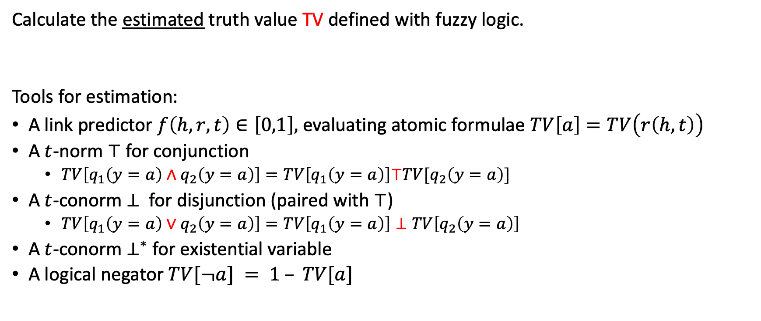
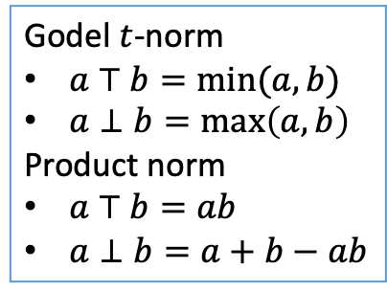
Fuzzy Inference with Truth values
Calculate the estimated truth value TV defined with fuzzy logic.
Tools for estimation:
A link predictor $f\left(h,r,t\right)∈\left[0,1\right],$ evaluating atomic formulae $TV\left[a\right]=TV\left(r\left(h,t\right)\right)$
A $t$-norm $⊤$ for conjunction
$TV\left[q_{1}\left(y=a\right)∧q_{2}\left(y=a\right)\right]=TV\left[q_{1}\left(y=a\right)\right]⊤TV[q_{2}\left(y=a\right)]$
A $t$-conorm $⊥$ for disjunction (paired with $⊤$)
$TV\left[q_{1}\left(y=a\right)∨q_{2}\left(y=a\right)\right]=TV\left[q_{1}\left(y=a\right)\right]⊥TV\left[q_{2}\left(y=a\right)\right]$
A $t$-conorm $⊥^{∗}$ for existential variable
A logical negator $TV[¬a] = 1 – TV[a]$
Godel $t$-norm
$a ⊤ b=\min{(a,b)}$
$a⊥b=\max\left(a,b\right)$
Product norm
$a ⊤ b=ab$
$a⊥b=a+b−ab$
Notes:
add back the example

Slide 10
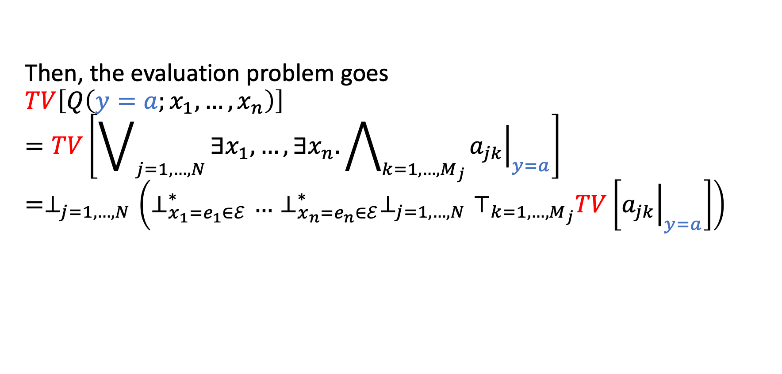
Fuzzy Inference with Truth values
Then, the evaluation problem goes
$$TV\left[Q\left(y=a;x_{1},…,x_{n}\right)\right]$$
$$=TV\left[\bigvee_{j=1,…,N}{∃x_{1},…,∃x_{n}.\bigwedge_{k=1, …,M_{j}}{{\left.a_{jk}\right|}_{y=a}}}\right]=⊥_{j=1,…,N}\left(⊥_{x_{1}=e_{1}∈ℰ}^{∗}…⊥_{x_{n}=e_{n}∈ℰ}^{∗}⊥_{j=1,…,N}⊤_{k=1,…,M_{j}}TV\left[{\left.a_{jk}\right|}_{y=a}\right]\right)$$
Notes:
add back the example

Slide 11
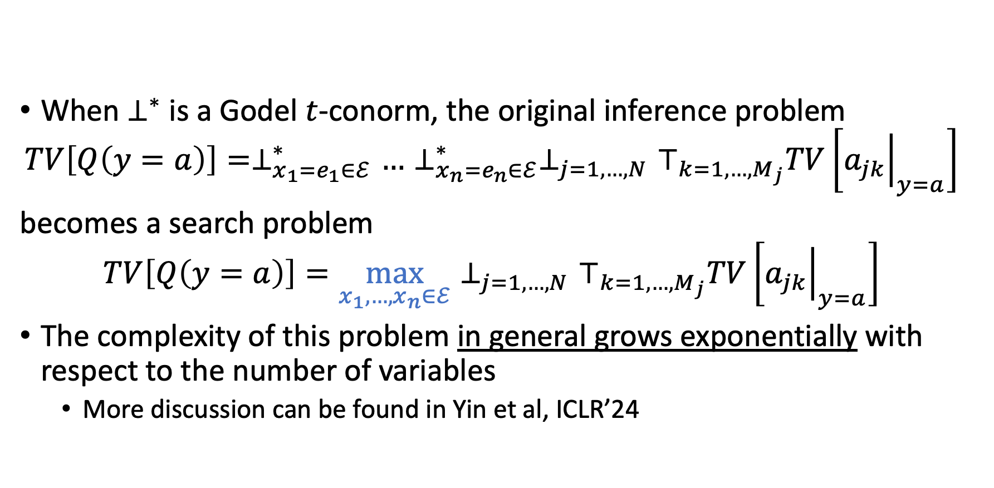
Fuzzy Inference with Truth values
When $⊥^{∗}$ is a Godel $t$-conorm, the original inference problem
$$TV\left[Q\left(y=a\right)\right]=⊥_{x_{1}=e_{1}∈ℰ}^{∗}…⊥_{x_{n}=e_{n}∈ℰ}^{∗}⊥_{j=1,…,N}⊤_{k=1,…,M_{j}}TV\left[{\left.a_{jk}\right|}_{y=a}\right]$$
becomes a search problem
$$TV\left[Q\left(y=a\right)\right]=\max_{x_{1},…,x_{n}∈ℰ}{⊥_{j=1,…,N}⊤_{k=1,…,M_{j}}TV\left[{\left.a_{jk}\right|}_{y=a}\right]}$$
The complexity of this problem in general grows exponentially with respect to the number of variables
More discussion can be found in Yin et al, ICLR’24
Yin, H., Wang, Z., & Song, Y. (2024). Rethinking Complex Queries on Knowledge Graphs with Neural Link Predictors. In The Twelfth International Conference on Learning Representations.

Slide 12
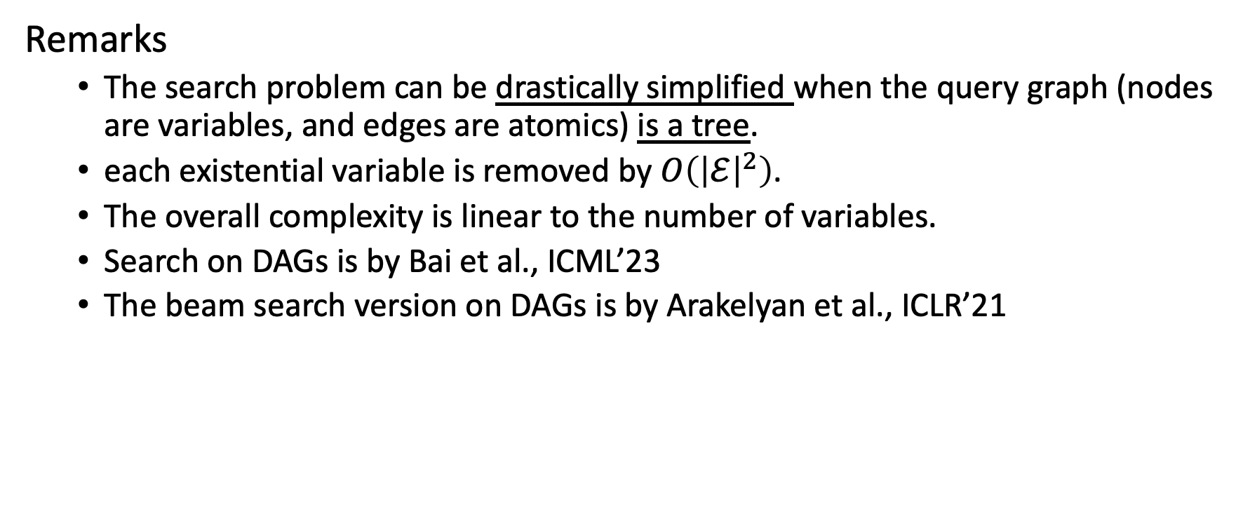
A simpler case of the inference problem
Remarks
The search problem can be drastically simplified when the query graph (nodes are variables, and edges are atomics) is a tree.
each existential variable is removed by $O\left({\left|ℰ\right|}^{2}\right)$.
The overall complexity is linear to the number of variables.
Search on DAGs is by Bai et al., ICML’23
The beam search version on DAGs is by Arakelyan et al., ICLR’21
Answering Complex Logical Queries on Knowledge Graphs via Query Computation Tree OptimizationY Bai, X Lv, J Li, L Hou ICML 2023
Complex Query Answering with Neural Link Predictors E Arakelyan, D Daza, P Minervini, M Cochez International Conference on Learning Representations (ICLR) 2021
Notes:
add concepts

Slide 13
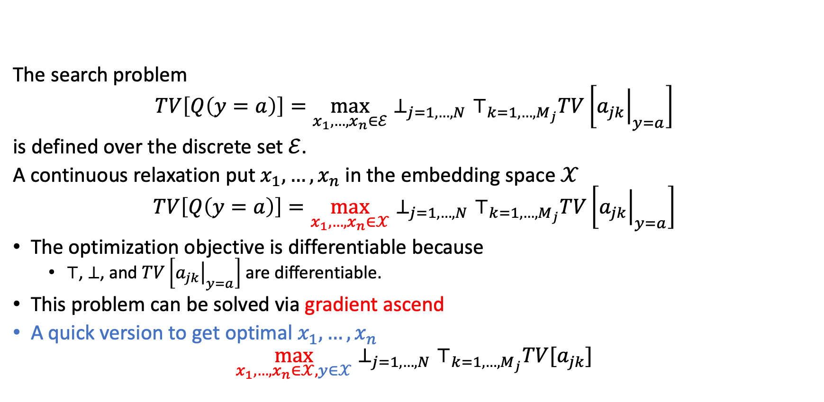
Search in the continuous space
The search problem
$$TV\left[Q\left(y=a\right)\right]=\max_{x_{1},…,x_{n}∈ℰ}{⊥_{j=1,…,N}⊤_{k=1,…,M_{j}}TV\left[{\left.a_{jk}\right|}_{y=a}\right]}$$
is defined over the discrete set $ℰ$.
A continuous relaxation put $x_{1},…,x_{n}$ in the embedding space $𝒳$
$$TV\left[Q\left(y=a\right)\right]=\max_{x_{1},…,x_{n}∈𝒳}{⊥_{j=1,…,N}⊤_{k=1,…,M_{j}}TV\left[{\left.a_{jk}\right|}_{y=a}\right]}$$
The optimization objective is differentiable because
$⊤$, $⊥$, and $TV\left[{\left.a_{jk}\right|}_{y=a}\right]$ are differentiable.
This problem can be solved via gradient ascend
A quick version to get optimal $x_{1},…,x_{n}$
$$\max_{x_{1},…,x_{n}∈𝒳,y∈𝒳}{⊥_{j=1,…,N}⊤_{k=1,…,M_{j}}TV[a_{jk}]}$$
Arakelyan, E., Daza, D., Minervini, P., & Cochez, M. (2021). Complex Query Answering with Neural Link Predictors. In International Conference on Learning Representations.

Slide 14
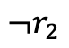
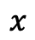
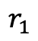
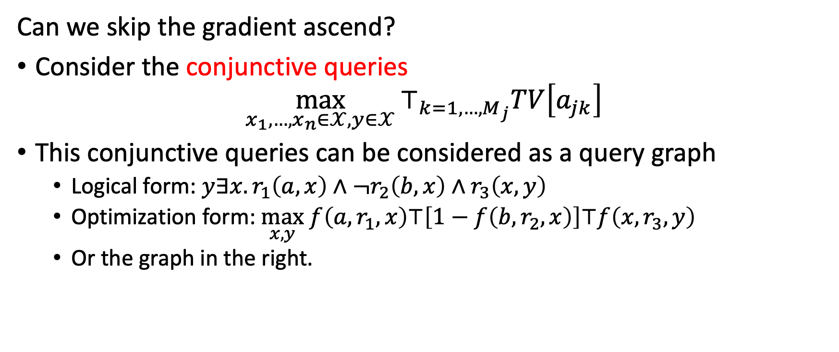
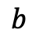
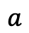
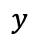
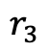
Learning to optimize in the continuous space
Can we skip the gradient ascend?
Consider the conjunctive queries
$$\max_{x_{1},…,x_{n}∈𝒳,y∈𝒳}{⊤_{k=1,…,M_{j}}TV\left[a_{jk}\right]}$$
This conjunctive queries can be considered as a query graph
Logical form: $y∃x.r_{1}\left(a,x\right)∧{¬r}_{2}\left(b,x\right)∧r_{3}\left(x,y\right)$
Optimization form: $\max_{x,y} f\left(a,r_{1},x\right)⊤\left[1−f\left(b,r_{2},x\right)\right]⊤f\left(x,r_{3},y\right)$
Or the graph in the right.
$$a$$
$$r_{1}$$
$$r_{3}$$
$$x$$
$$y$$
$$¬r_{2}$$
$$b$$

Slide 15
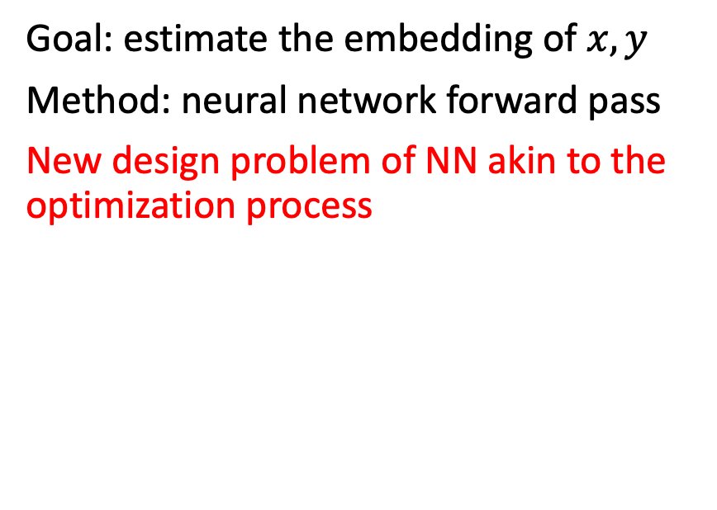
Learning to optimize in the continuous space
Optimize
Learning to optimize
Goal: optimize the embedding of $x,y$
Method: gradient ascend
$$\max_{x,y}f\left(a,r_{1},x\right)⊤\left[1−f\left(b,r_{2},x\right)\right]⊤f\left(x,r_{3},y\right)$$
Goal: estimate the embedding of $x,y$
Method: neural network forward pass
New design problem of NN akin to the optimization process
$$a$$
$$r_{1}$$
$$r_{3}$$
$$x$$
$$y$$
$$¬r_{2}$$
$$b$$

Slide 16
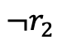
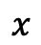
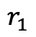
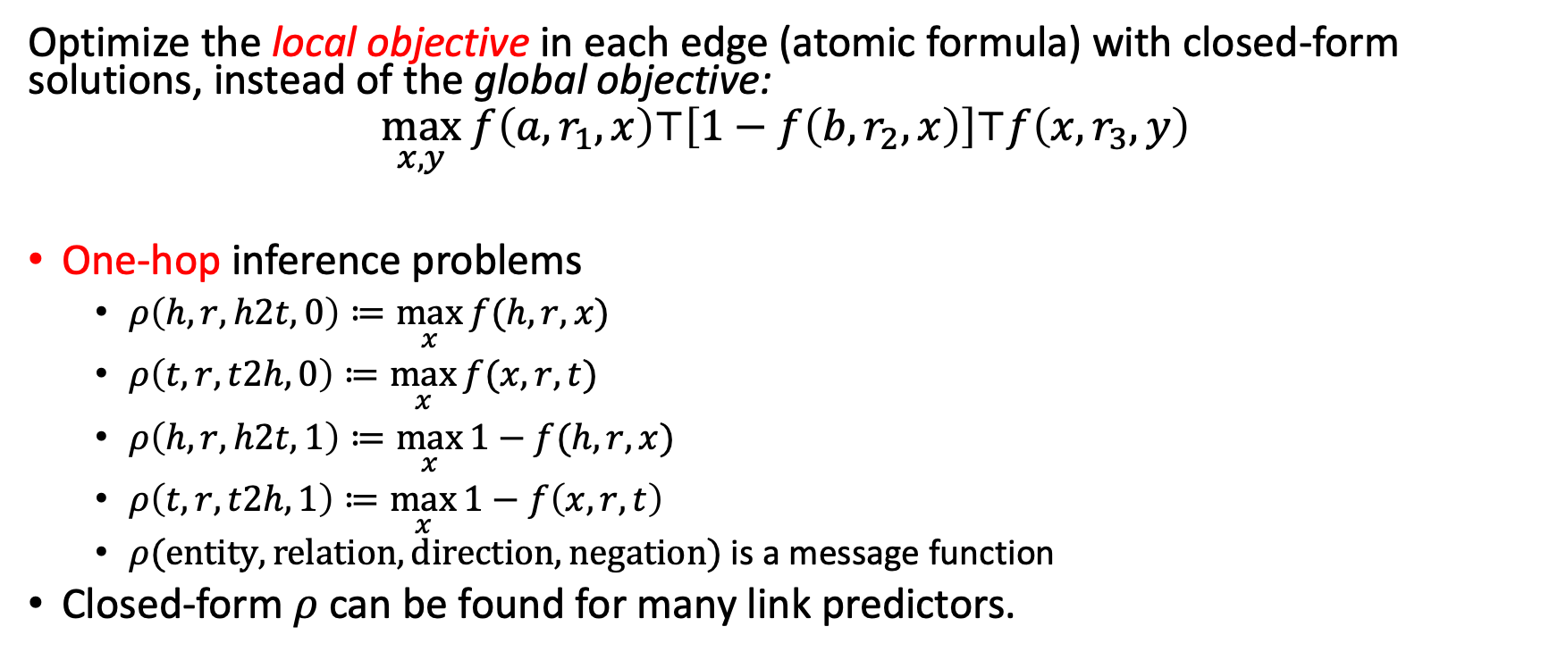
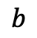
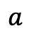
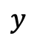
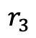
Learning to optimize in the continuous space
Optimize the local objective in each edge (atomic formula) with closed-form solutions, instead of the global objective:
$$\max_{x,y} f\left(a,r_{1},x\right)⊤\left[1−f\left(b,r_{2},x\right)\right]⊤f\left(x,r_{3},y\right)$$
One-hop inference problems
$ρ\left(h,r,h2t,0\right)≔\max_{x}{f(h,r,x)}$
$ρ\left(t,r,t2h,0\right)≔\max_{x}{f(x,r,t)}$
$ρ\left(h,r,h2t,1\right)≔\max_{x}{1−f(h,r,x)}$
$ρ\left(t,r,t2h,1\right)≔\max_{x}{1−f\left(x,r,t\right)}$
$ρ(entity,relation,direction,negation)$ is a message function
Closed-form $ρ$ can be found for many link predictors.
$$a$$
$$r_{1}$$
$$r_{3}$$
$$x$$
$$y$$
$$¬r_{2}$$
$$b$$
Wang, Z., Song, Y., Wong, G. Y., & See, S. (2023). Logical message passing networks with one-hop inference on atomic formulas. ICLR’23.

Slide 17
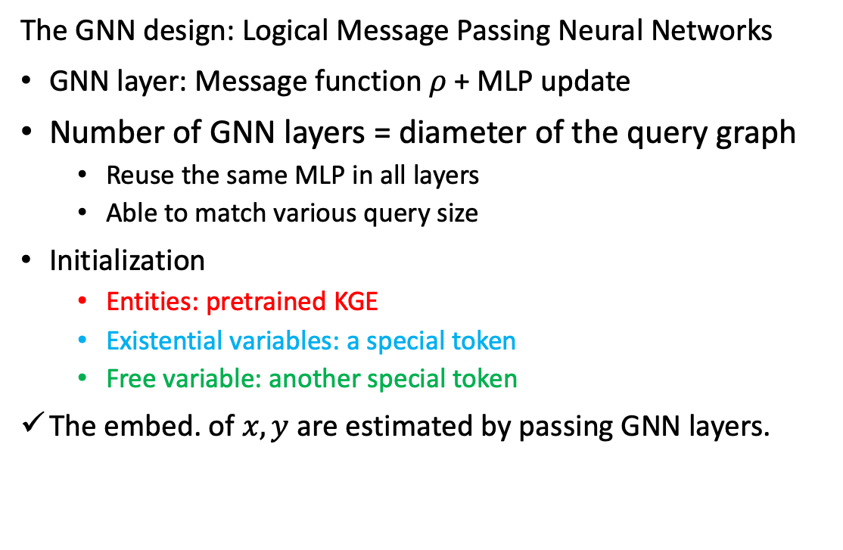
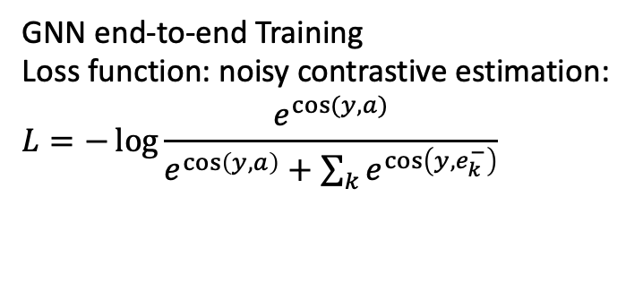
Learning to search in the continuous space
$$ρ(a,r_{1},h2t,0)$$
The GNN design: Logical Message Passing Neural Networks
GNN layer: Message function $ρ$ + MLP update
Number of GNN layers = diameter of the query graph
Reuse the same MLP in all layers
Able to match various query size
Initialization
Entities: pretrained KGE
Existential variables: a special token
Free variable: another special token
The embed. of $x,y$ are estimated by passing GNN layers.
$$a$$
$$ρ(x,r_{1}, t2h,0)$$
$$r_{1}$$
$$ρ(x,r_{3}, h2t,0)$$
$$r_{3}$$
$$ρ(x,r_{1},t2h,1)$$
$$¬r_{2}$$
$$x$$
$$y$$
$$ρ(y,r_{3}, t2h,0)$$
$$b$$
$$ρ(b,r_{1},h2t,1)$$
GNN end-to-end Training
Loss function: noisy contrastive estimation:
$$L=−\log{\frac{e^{cos⁡(y,a)}}{e^{\cos\left(y,a\right)}+\sum_{k}{e^{\cos\left(y,e_{k}^{−}\right)}}}}$$
Wang, Z., Song, Y., Wong, G. Y., & See, S. (2023). Logical message passing networks with one-hop inference on atomic formulas. ICLR’23.

Slide 18


Strategy II: end-to-end training
Enriched KG
$$A_{e}$$
Inference
Query
Neural Models
Training
Observed KG
Query Engine
$$A_{o}$$

Slide 19






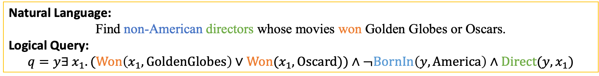
What to neuralize?
Presentation | Model type | Example | Logic Modules
Linearization into string | Sequence models | Transformer | Weak
Graph of terms and predicates | Graph models | GNN | Mid
Process of execution | Neural Set Operators | Query Embedding | Strong
Natural Language:
Find non-American directors whose movies won Golden Globes or Oscars.
Logical Query:
$$q=y∃ x_{1}.(Won\left(x_{1},GoldenGlobes\right)∨Won(x_{1},Oscard))∧¬BornIn\left(y,America\right)∧Direct(y,x_{1})$$
Set Operators
P
DirectorOf
set operations
GoldenGlobes
$$∪$$
set union
WinnerOf
$$∪$$
P
$$∩$$
set intersection
P
Oscars
Answer Set
$$C$$
set complement
BornIn
America
P
$$C$$
$$∩$$
P
set projection

Slide 20
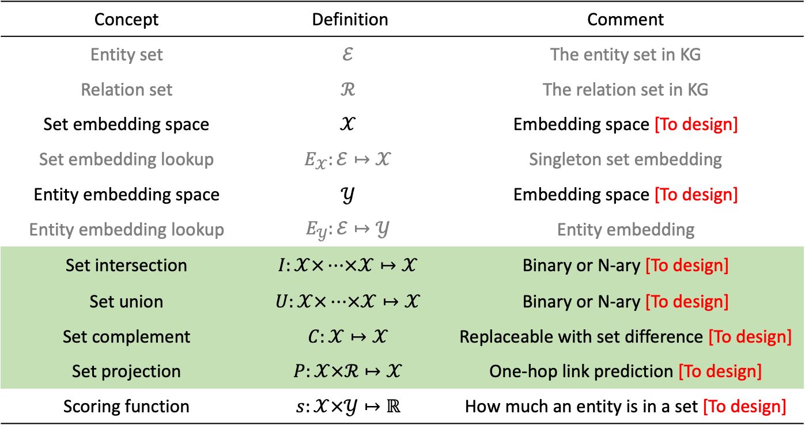


The design space of neural set operators
Concept | Definition | Comment
Entity set | $$ℰ$$ | The entity set in KG
Relation set | $$ℛ$$ | The relation set in KG
Set embedding space | $$𝒳$$ | Embedding space [To design]
Set embedding lookup | $$E_{𝒳}:ℰ↦𝒳$$ | Singleton set embedding
Entity embedding space | $$𝒴$$ | Embedding space [To design]
Entity embedding lookup | $$E_{𝒴}:ℰ↦𝒴$$ | Entity embedding
Set intersection | $$I:𝒳×…×𝒳↦𝒳$$ | Binary or N-ary [To design]
Set union | $$U:𝒳×…×𝒳↦𝒳$$ | Binary or N-ary [To design]
Set complement | $$C:𝒳↦𝒳$$ | Replaceable with set difference [To design]
Set projection | $$P:𝒳×ℛ↦𝒳$$ | One-hop link prediction [To design]
Scoring function | $$s:𝒳×𝒴↦ℝ$$ | How much an entity is in a set [To design]
Converting to computational tree
makes it possible to model
set operations with neural
networks
Set Operators
$$∪$$
set union
set operations
$$∩$$
set intersection
$$C$$
set complement
P
set projection
Wang, Z., Yin, H., & Song, Y. (2021). Benchmarking the combinatorial generalizability of complex query answering on knowledge graphs. NeurIPS 2021, Dataset and Benchmarks.

Slide 21
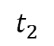
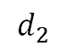
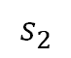
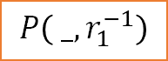
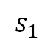
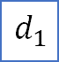
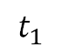
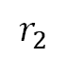
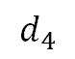
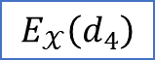
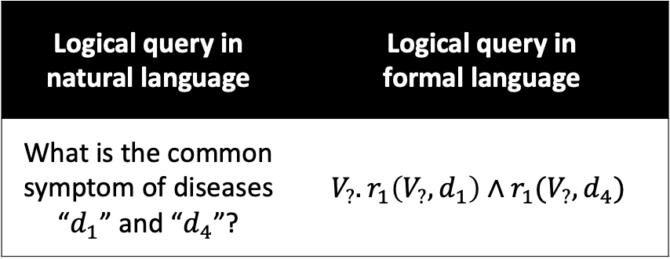
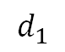
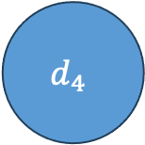
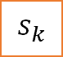
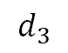
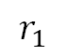
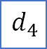












An example of set operation
Symptom
Disease
Treatment
$$s_{1}$$
$$r_{1}$$
$$d_{1}$$
$$t_{1}$$
$$r_{2}$$
$$s_{2}$$
$$d_{2}$$
$$t_{2}$$
Logical query in natural language | Logical query in formal language
What is the common symptom of diseases “$d_{1}$” and “$d_{4}$”? | $$V_{?}. r_{1}\left(V_{?},d_{1}\right)∧r_{1}(V_{?},d_{4})$$
$$s_{3}$$
$$d_{3}$$
$$t_{3}$$
Set Intersection
$$s_{4}$$
$$d_{4}$$
$$t_{4}$$
$$d_{1}$$
$$r_{1}$$
$$V_{?}$$
$$r_{1}$$
$$d_{4}$$
Traversal on the knowledge graph
The computational DAG
$$d_{1}$$
$$E_{𝒳}\left(d_{1}\right)$$
$$P\left( _,r_{1}^{−1}\right)$$
$$I\left( _,_\right)$$
$${E_{𝒴}(s}_{k})$$
$$s_{k}$$
Computation of query embedding: $\hat{y}=I\left(P\left(E_{𝒳}\left(d_{1}\right),r_{1}^{−1}\right),P\left(E_{𝒳}\left(d_{4}\right),r_{1}^{−1}\right)\right)$
Rank entities by $s\left(\hat{y},{E_{𝒴}(s}_{1})\right),s\left(\hat{y},{E_{𝒴}(s}_{2})\right)$,…
$$d_{4}$$
$$E_{𝒳}\left(d_{4}\right)$$
$$P\left( _,r_{1}^{−1}\right)$$

Slide 22



Examples in $ℝ^{d}$: Vector
GQE (Hamilton et al., 2018)
$MLP$: multi-layer perceptron
$Ψ$: a permutation invariant operator
$W$: a matrix
$R_{r}$: a matrix indexed by relation $r$
Neural operations do almost everything
Definition | Comment
$$𝒳$$ | $$q∈ℝ^{d}$$
$$𝒴$$ | $${a∈ℝ}^{d}$$
$$I:𝒳×…×𝒳↦𝒳$$ | $$I\left(q_{1},…,q_{n}\right)=WΨ\left(MLP\left(q_{1}\right),…,MLP\left(q_{n}\right)\right)$$
$$U:𝒳×…×𝒳↦𝒳$$ | UCQ equivalent forms
$$C:𝒳↦𝒳$$ | NA
$$P:𝒳×ℛ↦𝒳$$ | $$P\left(q,r\right)=R_{r}q$$
$$s:𝒳×𝒴↦ℝ$$ | $$s\left(q,a\right)=\frac{q^{T}a}{\left\|q\right\|\left\|a\right\|}$$
Hamilton, W., Bajaj, P., Zitnik, M., Jurafsky, D., & Leskovec, J. (2018). Embedding logical queries on knowledge graphs. Advances in neural information processing systems, 31.

Slide 23



Example in $ℝ^{d}$: multiple vector
Query2Particles (Bai et al., 2022)
Because of multiple particles describe one set, then we can describe the set union in a natural way.
Meanwhile, it enables many advanced neural network architectures Such as
self-attention
Gates
Definition | Comment
$$𝒳$$ | Multiple vectors in $ℝ^{d}$
$$𝒴$$ | $$ℝ^{d}$$
$$I:𝒳×…×𝒳↦𝒳$$ | $A_{i}$= self-attn($P_{i}$) $P_{i+1}$ = MLP($A_{i}$)
$$U:𝒳×…×𝒳↦𝒳$$ | Merge Particles
$$C:𝒳↦𝒳$$ | $$A_{i} \text{= }\text{self}\text{−}\text{attn}\text{(}P_{i}\text{)}$$ $$P_{i+1}\text{ = }\text{MLP}\text{(}A_{i}\text{)}$$
$$P:𝒳×ℛ↦𝒳$$ | $A_{i}$ = (1 - $Z$) ${⊙P}_{i}$ + $Z⊙T$ $$P\left(q,r\right)=\text{self}\text{−}\text{attn}\text{(}A_{i}\text{)}$$
$$s:𝒳×𝒴↦ℝ$$ | $$s\left(q,a\right)=\max_{k=1,2,3,…,K}{<p_{T}^{(k)}, a> }$$
Gated Transition for customizing the directions of transitions for each vector in particles:
$A_{i}$ = (1 - $Z$) ${⊙P}_{i}$ + $Z⊙T$
Here $Z$ is the update gate, and $T$ is transition for each particles. They are computed from $P_{i}$ and the relation embedding $e_{l}$ for relation $l$
Bai, J., Wang, Z., Zhang, H., & Song, Y. (2022, July). Query2Particles: Knowledge Graph Reasoning with Particle Embeddings. In Findings of the Association for Computational Linguistics: NAACL 2022 (pp. 2703-2714).

Slide 24





Example in Geometric regions
Query2Box (Ren et al., 2020)
Natural abstraction of set intersection
Definition | Comment
$$𝒳$$ | $q$ is a box in $ℝ^{d}$
$$𝒴$$ | $${a∈ℝ}^{d}$$
$$I:𝒳×…×𝒳↦𝒳$$ | $$q_{I}=I\left(q_{1},…,q_{i},…,q_{n}\right)$$ $$c^{I}=∑a_{i}c^{q_{i}}, a_{i}={softmax}_{i=1,…,n}\left(MLP(q_{i})\right)$$ $$w^{I}=\min\left\{w^{q_{1}},…,w^{q_{n}}\right\}σ(Deepset(q_{1},…,q_{n}))$$
$$U:𝒳×…×𝒳↦𝒳$$ | UCQ
$$C:𝒳↦𝒳$$ | NA
$$P:𝒳×ℛ↦𝒳$$ | $$Box\left(c^{P\left(q,r\right)},w^{P\left(q,r\right)}\right)=Box(c_{q}+c_{r},w_{q}+w_{r})$$
$$s:𝒳×𝒴↦ℝ$$ | $$s\left(q,a\right)=γ−dist_{outside}\left(q,a\right)−αdist_{inside}(q,a)$$
$$q_{1}=(c^{q_{1}},w^{q_{1}})$$
$$q_{I}=(c^{I},w^{I})$$
$$q_{2}=(c^{q_{2}},w^{q_{2}})$$
Training objective $L\left(q\right)=−\log{σ\left(s\left(q,a\right)\right)−\sum_{j=1,…,k}{\frac{1}{k}\log{σ\left(s\left(q,e_{j}^{−}\right)\right)}}}$
Ren, H., Hu, W., & Leskovec, J. (2020). Query2box: Reasoning over knowledge graphs in vector space using box embeddings. arXiv preprint arXiv:2002.05969.

Slide 25



Example in Probabilistic distributions
BetaE (Ren and Leskovec, 2020)
Q: How to model the set complement?
A: Use inductive bias of probability families
P.d.f. of Beta distribution $Beta\left(α,β\right)$
$$f\left(x;α,β\right)=\frac{Γ\left(α+β\right)}{Γ\left(α\right)Γ\left(β\right)}x^{α−1}{\left(1−x\right)}^{β−1}$$
where $Γ\left(x\right)$ is the Gamma function.
Set embedding: $d$ Beta distributions.
Definition | Comment
$$𝒳$$ | $$q=\left(α_{1}^{q},β_{1}^{q},…,α_{d}^{q},β_{d}^{q}\right)∈{\left[0,∞\right)}^{2d}$$
$$𝒴$$ | $${a∈[0,∞)}^{2d}$$
$$I:𝒳×…×𝒳↦𝒳$$ | $$I\left(q_{1},…,q_{i},…,q_{n}\right)=\sum_{i}{α_{i}q_{i}},$$ $$α_{i}=softmax\left(NN\left(q_{i}\right)\right)$$
$$U:𝒳×…×𝒳↦𝒳$$ | UCQ
$$C:𝒳↦𝒳$$ | $$C\left(q\right)=1/q$$
$$P:𝒳×ℛ↦𝒳$$ | $$P\left(q,r\right)={MLP}_{r}(q)$$
$$s:𝒳×𝒴↦ℝ$$ | $$s\left(q,a\right)=γ−\sum_{i=1,…,d}{KL\left(B\left(α_{i}^{q},β_{i}^{q}\right)|B\left(α_{i}^{a},β_{i}^{a}\right)\right)}$$
Ren, H., & Leskovec, J. (2020). Beta embeddings for multi-hop logical reasoning in knowledge graphs. Advances in Neural Information Processing Systems, 33, 19716-19726.

Slide 26

Can “embeddings” also be logical aware?
A matrix $M_{q,a}=TV\left(q\left(y=a\right)\right)$ records everything we need. where $q$ is an arbitrary query and $a$ is an entity.
$$s\left(q,a\right)=M_{q,a}$$
$M_{q,a}$looks large
$M^{atomic}$ for finite positive atomic queries (h, r, ?) are necessary
Other rows can be generated by fuzzy logic inference (we’ve introduced in FIT)
Low rank decomposition of $M^{atomic}$.
$$M_{q,a}^{atomic}≈{\vec{q}}^{T}\vec{a}$$
${\vec{q}}^{T}∈ℝ^{d}$ is the query embedding of an atomic query $q(y)=r(e,y)$.
Any atomic query can be written as $q\left(y\right)=r\left(e,y\right)$ by allowing reverse relation.

Slide 27

Matrix decomp. leads to element-wise fuzzy logic ops
Low rank (rank $d$) decomposition of $M^{atomic}$
$$M_{q,a}^{atomic}≈{\vec{q}}^{T}\vec{a}$$
$\vec{q}$ is the query embedding
$\vec{a}$ is the entity embedding
If we further assume that
$\vec{q}∈{\left[0,1\right]}^{d}$,$\vec{a}∈{\left[0,1\right]}^{d}$
$t$-norm is linear, for convenience we consider Godel $t$-norm
Let $q_{1},q_{2}$ be atomic query, and godel norm, then
$$M_{q_{1}∧q_{2},a}={\vec{q_{1}∧q_{2}}}^{T}\vec{a}=M_{q_{1},a}⊤M_{q_{2},a}=\min\left(M_{q_{1},a},M_{q_{2},a}\right)=\min\left({\vec{q_{1}}}^{T}\vec{a}, {\vec{q_{2}}}^{T}\vec{a}\right)=\min{({\vec{q_{1}}}^{T}, {\vec{q_{2}}}^{T}) }\vec{a}$$
Conclusion:
$$\vec{q_{1}∧q_{2}}=min\left(\vec{q_{1}},\vec{q_{2}}\right)=\vec{q_{1}}⊤\vec{q_{2}}$$
$$\vec{q_{1}∨q_{2}}=max\left(\vec{q_{1}},\vec{q_{2}}\right)=\vec{q_{1}}⊥\vec{q_{2}}$$
$$\vec{{¬q}_{1}}=1−\vec{q_{1}}$$

Slide 28

From vector to Fuzzy vector
FuzzQE (Chen et al., 2022)
Definition | Comment
$$𝒳$$ | $$q∈{\left[0,1\right]}^{d}$$
$$𝒴$$ | $${a∈\left[0,1\right]}^{d}$$
$$I:𝒳×…×𝒳↦𝒳$$ | $$I\left(q_{1},…,q_{i},…,q_{n}\right)=q_{1}⊤…⊤q_{n}$$
$$U:𝒳×…×𝒳↦𝒳$$ | $$U\left(q_{1},…,q_{i},…,q_{n}\right)=q_{1}⊥…⊥q_{n}$$
$$C:𝒳↦𝒳$$ | $$C\left(q\right)=1−q$$
$$P:𝒳×ℛ↦𝒳$$ | $$P\left(q,r\right)={MLP}_{r}(q)$$
$$s:𝒳×𝒴↦ℝ$$ | $$s\left(q,a\right)=q^{T}a$$
T-norms are all you need
Chen, X., Hu, Z., & Sun, Y. (2022, June). Fuzzy logic based logical query answering on knowledge graphs. In Proceedings of the AAAI Conference on Artificial Intelligence (Vol. 36, No. 4, pp. 3939-3948).

Slide 29


From fuzzy vectors back to geometric region
WFRE (Wang et al., 2023)
Definition | Comment
$$𝒳$$ | $$q∈{\left[0,1\right]}^{d}$$
$$𝒴$$ | $${a∈\left[0,1\right]}^{d}$$
$$I:𝒳×…×𝒳↦𝒳$$ | $$I\left(q_{1},…,q_{i},…,q_{n}\right)=q_{1}⊤…⊤q_{n}$$
$$U:𝒳×…×𝒳↦𝒳$$ | $$U\left(q_{1},…,q_{i},…,q_{n}\right)=q_{1}⊥…⊥q_{n}$$
$$C:𝒳↦𝒳$$ | $$C\left(q\right)=1−q$$
$$P:𝒳×ℛ↦𝒳$$ | $$P\left(q,r\right)={MLP}_{r}(q)$$
$$s:𝒳×𝒴↦ℝ$$ | $$s\left(q,a\right)=ConvWFR\left(q,a\right)$$
WFR (Wasserstein-Fisher-Raw) distances
combines
1. “geometric” intuition such as box in 1D
2. The element-wise comparison
So that it supports both good intuition and fuzzy logic t-norms
Wang, Z., Fei, W., Yin, H., Song, Y., Wong, G. Y., & See, S. (2023). Wasserstein-Fisher-Rao Embedding: Logical Query Embeddings with Local Comparison and Global Transport. ACL 2023.

Slide 30

Summary of systems of neural set operations
Query representation
A natural decomposition for combinatorial generalizability.
The choices of operators can vary.
Several equivalent forms exist.
More details of such systems and how different choice affects the performance can be found in Wang et al., (NeurIPS’21)
Benchmarking the Combinatorial Generalizability of Complex Query Answering on Knowledge Graphs Z Wang, H Yin, Y Song 35th Conference on Neural Information Processing Systems (NeurIPS 2021 dataset and benchmark)

Slide 31
Summary of systems of neural set operations
Design of embedding spaces
Intuitions are essential for parameterization.
Many intuitions from KG embeddings also apply, pointing to many recent works.
Training and inferences
Inference is efficient; it can be done with almost constant data complexity
Because neural operations are usually in fixed dimensions.
Nearest Neighbor lookup can be sped up.
Training is standard by negative samples.
Recent works about meta-learning have helped to improve generalizability.
Key takeaway: Don’t consider meta models; consider meta operators. (Yin et al., 2024)
Yin, H., Wang, Z., & Song, Y. (2024). Meta Operator for Complex Query Answering on Knowledge Graphs. arXiv preprint arXiv:2403.10110.

Slide 32
Theoretical concerns:
What queries are we solving?
Strategy I (completion and search):
Existential First Order (EFO).
Strategy II (end-to-end learning, neural set operator):
“The queries that can be expressed in Trees”, let’s call it Tree-Form (TF) query.
Is TF the same as EFO ?

Slide 33

“The queries that can be expressed in Trees”
To formal define TFQ, we should describe logical queries that expresses
Atomic query (h, r, ?)
Set projection
Set complement
Set intersection
Set union
Let $𝒯$ be the set of all TFQs, then
$S_{atomic}∈𝒯$
If $φ\left(z\right)∈𝒯$, then
$$∃z.φ\left(z\right)∧r\left(z,y\right)∈𝒯$$
If $φ∈𝒯$, then
$$¬φ(y)∈𝒯$$
If $φ,ψ∈𝒯$, then
$$φ\left(y\right)∧^{∗}ψ\left(y\right)∈𝒯$$
$$φ\left(y\right)∨^{∗}ψ\left(y\right)∈𝒯$$
Note *: the existential variables in $φ(y)$ and $ψ(y)$ are assumed to be not shared.
$$x$$
$$y$$
$$x′$$
Yin, H., Wang, Z., & Song, Y. (2024). Rethinking Complex Queries on Knowledge Graphs with Neural Link Predictors. In The Twelfth International Conference on Learning Representations.

Slide 34


TFQ vs EFO: The difference in definition
Tree-form query
Existential First Order (EFO) query
Let $𝒯$ be the set of all TFQs, then
$S_{atomic}=\{r\left(h,y\right):r∈ℛ,h∈ℰ\} ∈𝒯$
$h$ is an entity, $y$ is a variable
If $φ∈𝒯$, then
$$¬φ(y)∈𝒯$$
If $φ,ψ∈𝒯$, then
$$φ\left(y\right)∧^{∗}ψ\left(y\right)∈𝒯$$
$$φ\left(y\right)∨^{∗}ψ\left(y\right)∈𝒯$$
Note*: the existential variables in $φ(y)$ and $ψ(y)$ are assumed to be not shared.
If $φ\left(z\right)∈𝒯$, then
$$∃z.φ\left(z\right)∧r\left(z,y\right)∈𝒯$$
Let $𝒬$ be the set of all EFO query, then
$F_{atomic}=\left\{r\left(t_{1},t_{2}\right),r∈ℛ\right\}∈𝒬$
$t_{1}$ and $t_{2}$ are either entities or variables.
If $φ∈F_{atomic}$, then
$$¬φ(y)∈𝒬$$
If $φ,ψ∈𝒬$, then
$$φ\left(y\right)∧ψ\left(y\right)∈𝒬$$
$$φ\left(y\right)∨ψ\left(y\right)∈𝒬$$
Note1: the existential variables in $φ(y)$ and $ψ(y)$ can be shared.
If $φ∈𝒬$ and $x$ is a variable, then
$$∃x. φ∈𝒬$$
Note2: we can always use this rule to make sure there is only one free variable (non-quantified). This subset is also known as $EFO_{1}$.
$$CQ_{j}\left(y;x_{1},…,x_{n}\right)=y.∃x_{1},…,∃x_{n}.\bigwedge_{k=1, …,M_{j}}{a_{jk}}$$
Yin, H., Wang, Z., & Song, Y. (2024). Rethinking Complex Queries on Knowledge Graphs with Neural Link Predictors. In The Twelfth International Conference on Learning Representations.

Slide 35

TFQ vs EFO: Are TFQ $𝒯$ the same as EFO $𝒬$?
$𝓣−𝓠$ is not empty
$𝓠−𝓣$ is not empty
Non-constant
negation
Construction:
$r_{1}\left(a,y\right)∈𝒯$
$∃x.r_{1}\left(a,x\right)∧r_{2}(x,y)∈𝒯$
$¬∃x.r_{1}\left(a,x\right)∧r_{2}(x,y)∈𝒯$
$φ\left(y\right)=∀x.¬r_{1}\left(a,x\right)∨¬r_{2}\left(x,y\right)$ $φ\left(y\right)∈𝒯$
There is a universal quantifier, so it is not existential.
Construction:
$r\left(x,y\right),r\left(y,z\right),r\left(z,x\right)∈𝒬$
$φ\left(y\right)=∃x,z.r\left(x,y\right)∧r\left(y,z\right)∧r\left(z,x\right)$
$$φ\left(y\right) ∈Q$$
This is a triangle but not a tree.
Leaf existential
$$y$$
$$x$$
$$z$$
Yin, H., Wang, Z., & Song, Y. (2024). Rethinking Complex Queries on Knowledge Graphs with Neural Link Predictors. In The Twelfth International Conference on Learning Representations.

Slide 36
Neural reasoning for logical query: summary
Logical query in DB:
Solves various forms of logical queries
Logical Reasoning in Enriched KG
Strategy I: first complete, then conduct logical inference.
Strategy II: mixture of completion and logical inference.
Still far away from SPARQL-compatible queries
Some key features are missing, such as:
multiple variables to answer. (Yin et al., 2023)
operators such as count, distinct, sort, …
Yin, H., Wang, Z., Fei, W., & Song, Y. (2023). $\text {EFO} _ {k} $-CQA: Towards Knowledge Graph Complex Query Answering beyond Set Operation. arXiv preprint arXiv:2307.13701.

Slide 37





Coffee Break: Resume in 11 AM
New Frontiers of Knowledge Graph Reasoning:
Recent Advances and Future Trends
Lihui Liu
Zihao Wang
Jiaxin Bai
Yangqiu Song
Hanghang Tong
lihuil2@illinois.edu zwanggc@cse.ust.hk jbai@connect.ust.hk yqsong@cse.ust.hk htong@illinois.edu

